Slide 1
Class 01 - Introduction

Slide 2
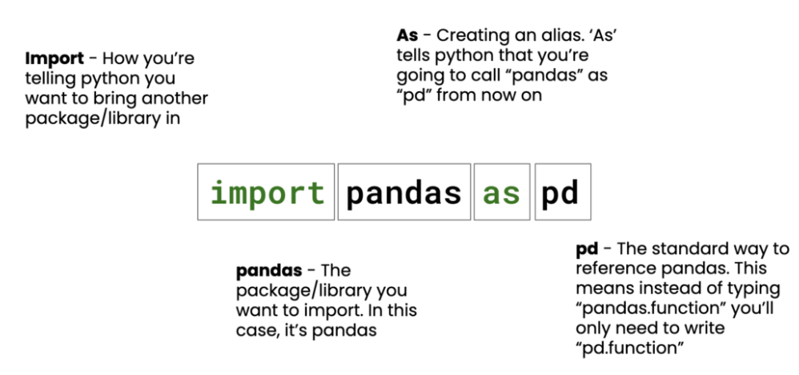
Loading Data - Pandas
Importing Libraries (= Packages)

Slide 3
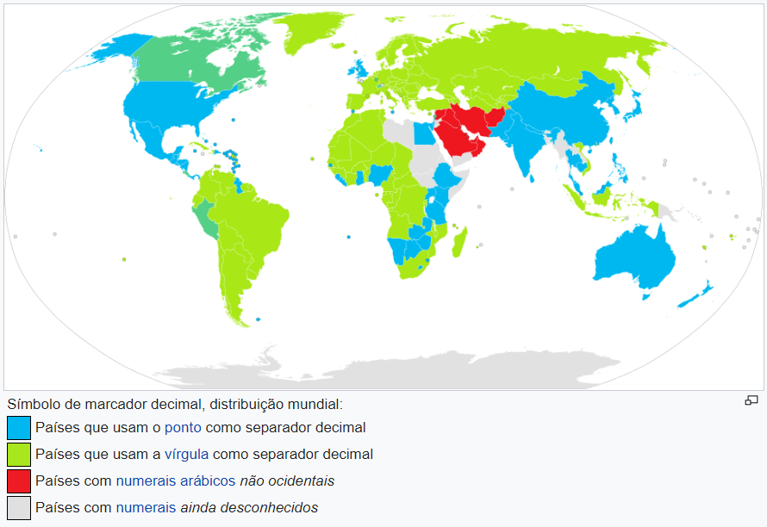
Decimal Separator
https://upload.wikimedia.org/wikipedia/commons/a/a8/DecimalSeparator.svg

Slide 4
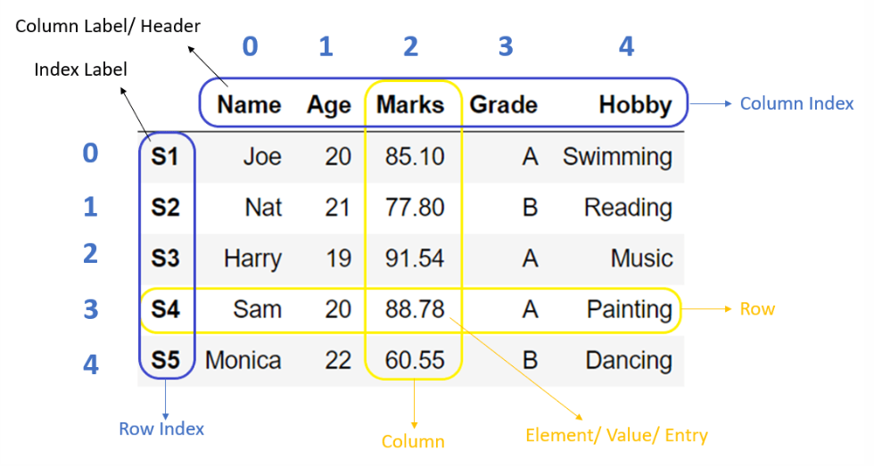
Data Frame
Notes:
Fonte: https://pynative.com/python-pandas-dataframe/

Slide 5
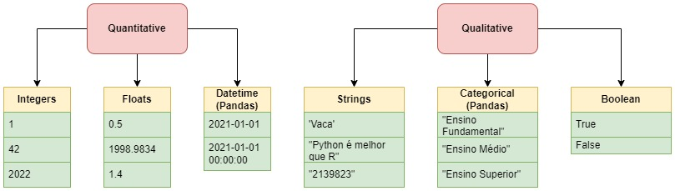
Data Types
Notes:
Integers → discrete
Floats → continuous
Strings → any alphanumeric sequence
Categorical → any alpanumeric sequence that implies an ORDINAL relation
Boolean → a binary

Slide 6
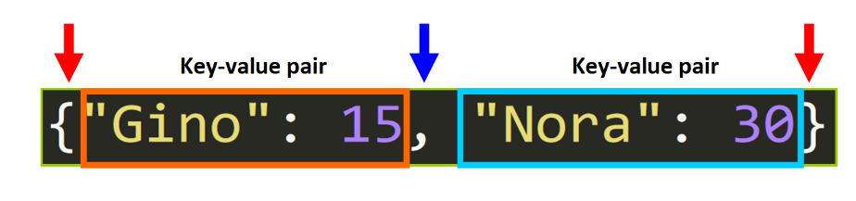
Dictionaries

Slide 7
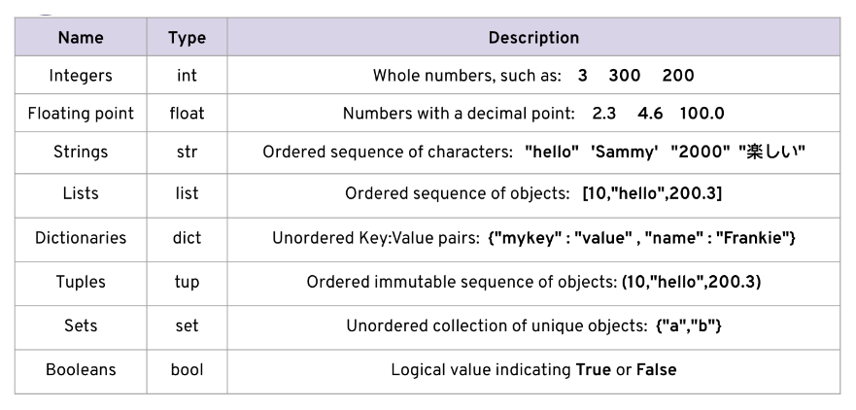
Data Types

Slide 8
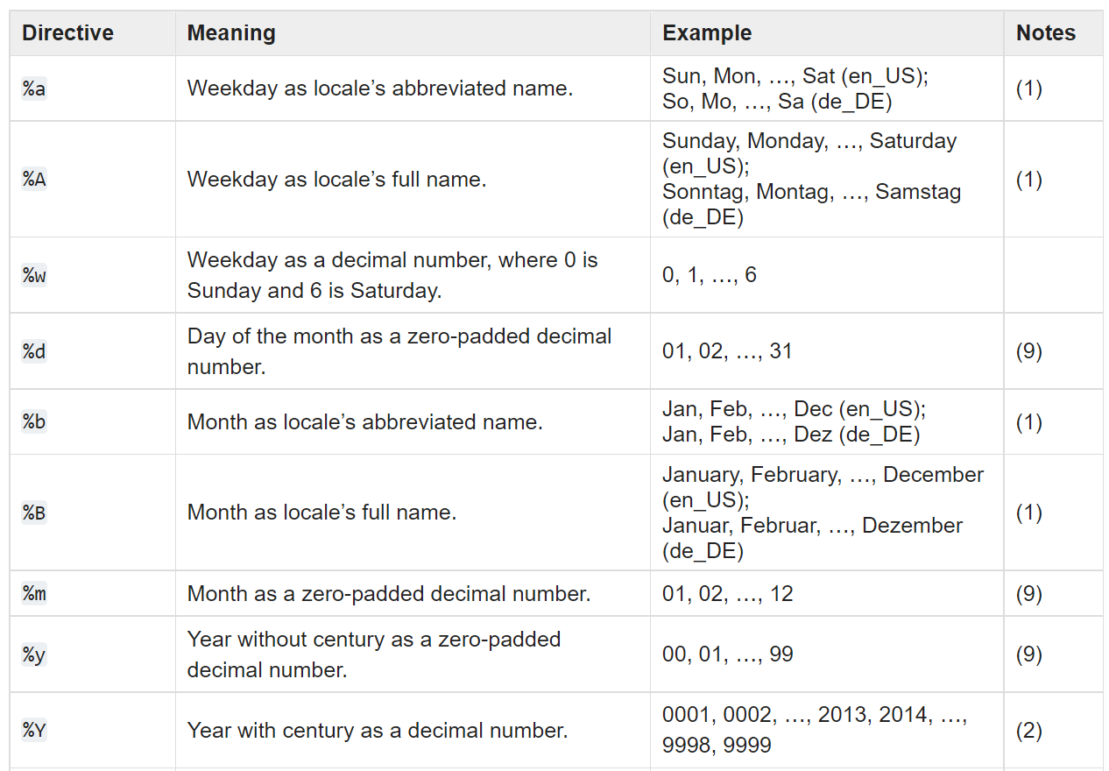
DateTimes
https://docs.python.org/3/library/datetime.html#strftime-and-strptime-format-codes
Search for strftime()

